Slide 1

Hotel Reservation Analysis in SQL
Represented by
Nardy Mechael Marey

Slide 2
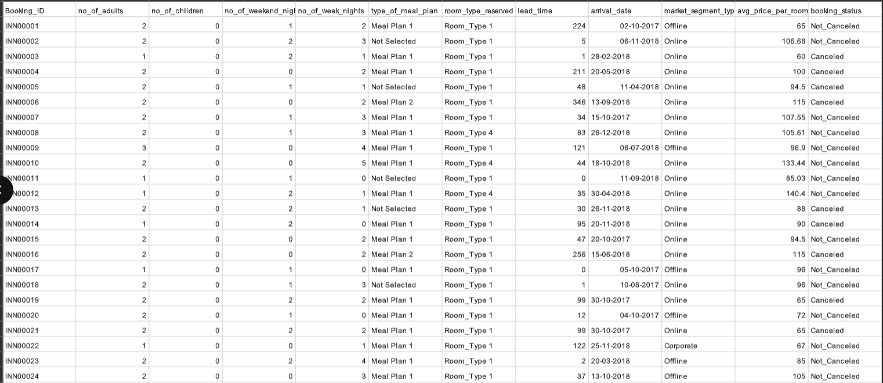
Data in Table

Slide 3
Steps of Data analysis in SQL
Create a Table.
Insert the data into the table.
Write sql code to analyze the data.

Slide 4
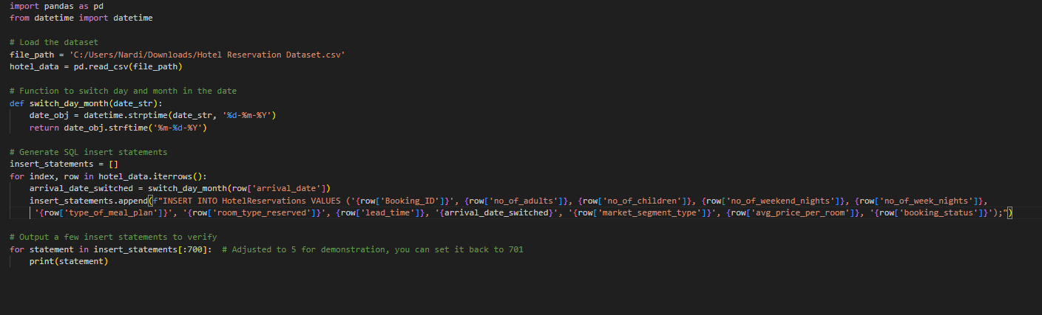
How to insert huge table without write everything manually ?

Slide 5
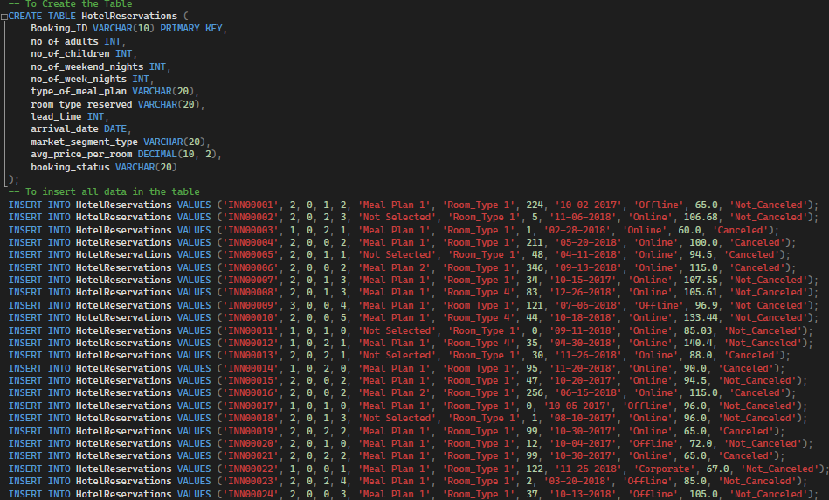
Creating and Inserting data

Slide 6
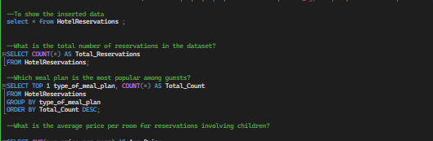
Writing the SQL code to analyze data

Slide 7
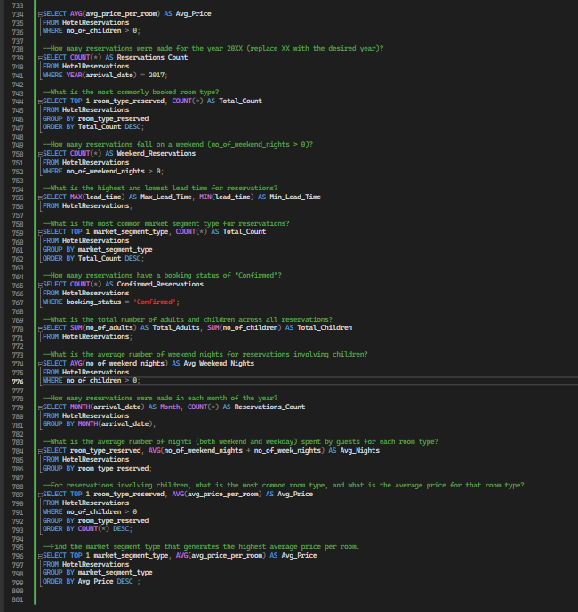
Writing the SQL code to analyze data

Slide 8
Writing the SQL code to analyze data

Slide 9
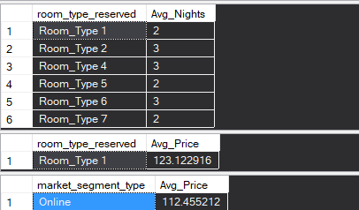
Output of the sql code

Slide 10
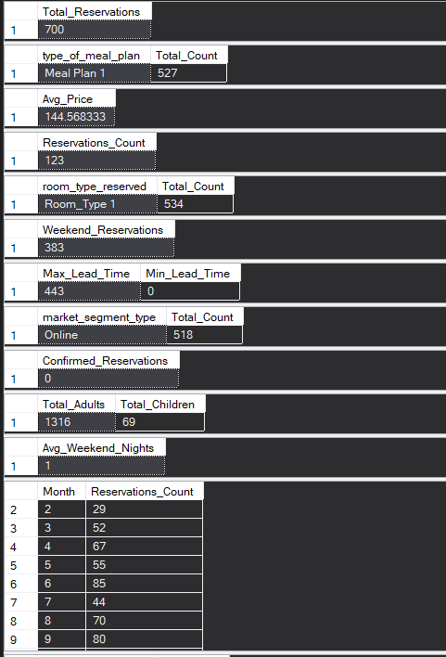
Output of the sql code

Slide 11
Output of the sql code

Slide 12
Thanks for your attention !

